Slide 1
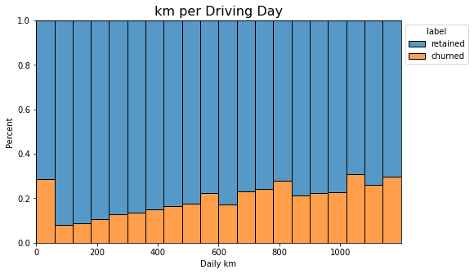
Executive Summary
User Churn Project | Exploratory Data Analysis
Prepared for: Waze Leadership Team
The Waze data team is currently developing a data analytics project aimed at increasing overall growth by preventing monthly user churn on the Waze app. Data team is required to perform Exploratory Data Analysis to provide insights from the dataset, prepare, and validate it for future ML models.
Preliminary EDA is complete.
Once concerns & questions regarding the data source is answered, ML model construction commences.
number of driving days and app usage days are roughly unformly distrubuted, however app usage days among churned users is concentrated on much less days.
Observations related to mileage are right-skewed, there are exceptional drivers with driving huge distances.
Churn rate = 17% , Retention rate = 83%
Device type has no effect on churn rate.
km_per_driving_day is significantly larger among churned users, where their driving_dayis much less than the rest of users.
Questions regarding data:
- Data-related questions need to be asked from the data team regarding 2nd insight.
- It should also be investigated by the data team why more than 40 % of app usages are done in the last month, despite sign ups having been done years ago!
- Reasons why drives_avg_speed_kmph is extremely heavily tailed above 300 kmph!
Once concerns & questions regarding the data source is answered, ML model construction commences.

Slide 2
Title
Subtitle
Project Overview
Image Alt-Text Here

Slide 3
Title
Subtitle
Image Alt-Text Here
Image Alt-Text Here

Slide 4
Title
Subtitle
Image Alt-Text Here

Slide 5
Title
Subtitle

Slide 6
Title
Subtitle
Image Alt-Text Here

Slide 7
Title
Subtitle

